Slide 1
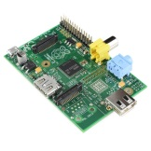
PHP & MySQL on Your RasPi
Yao-Tung Tsou

Slide 2
Setting up a PHP Web Server
We need
Apache2
PHP
Notes:
https://www.youtube.com/watch?v=w2itwFJCgFQ

Slide 3
Setting up a PHP Web Server
Apache is a popular web server application you can install on the Raspberry Pi to allow it to serve web pages.
You will use it to serve HTML files over HTTP.
Using scripting language, PHP, serves dynamic web pages.

Slide 4
Install Apache & Show Web
Install the apache2 package by typing the following command:
sudo apt-get install apache2 –y
Test your web server
By default, Apache puts a test HTML file in the web folder. This default web page is served when you browse to http://localhost/ on the Pi itself, or http://192.168.0.1 (whatever the Pi's IP address is)
Find Pi’s IP address
hostname -I

Slide 5
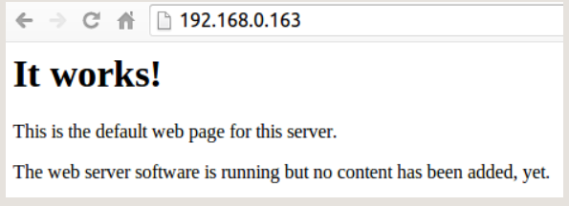
Show Your Web Server

Slide 6
Change the Default Web Page
This default web page is just a HTML file on the filesystem. It is located at /var/www/html/index.html. navigate to this directory in the Terminal and have a look at what's inside:
cd /var/www/html
ls -al

Slide 7
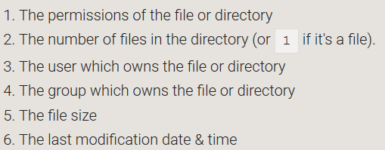
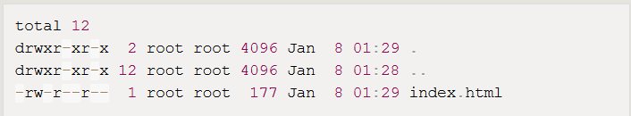
Change the Default Web Page
It will show you like:
This shows that there is one file in /var/www/ called index.html. The . refers to the directory itself /var/www/ and the “..” refers to the parent directory /var/.

Slide 8
Change the Default Web Page
If you know HTML you can put your own HTML files and other assets in this directory and serve them as a website on your local network.

Slide 9
Writing Your Own PHP
Install PHP
To allow your Apache server to process PHP files, you'll need to install PHP5 and the PHP5 module for Apache. Type the following command to install these:
sudo apt-get install php5 libapache2-mod-php5 -y

Slide 10
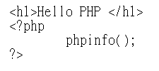
Writing Your Own PHP
Create the file ‘my.php’
sudo nano /var/www/my.php
Put some PHP content in it:
Then, “ctrl+o” to save and “ctrl+x” to leave
Open your browser and type “http://[your ip address]/my.php”

Slide 11
MySQL Database
I’m going to go through the steps to install MySQL server on your Raspberry Pi.
MySQL is more scalable,
MySQL can be tuned more easily,
It supports user management and permissions,
MySQL is better for sites with heavy traffic,
It can be used in client server architectures where a database client must access a database remotely.

Slide 12
Setting up a MySQL Server
Make sure your program is the latest.
sudo apt-get update ; sudo apt-get dist-upgrade -y
Install MySQL database tool
sudo apt-get install apache2 php5 php5-mysql mysql-server
php5-mysql provides functions and modules while PHP connects to mysql.
Notes:
upgrade: upgrade is used to install the newest versions of all packages currently installed on the system from the sources enumerated in /etc/apt/sources.list. Packages currently installed with new versions available are retrieved and upgraded; under no circumstances are currently installed packages removed, or packages not already installed retrieved and installed. New versions of currently installed packages that cannot be upgraded without changing the install status of another package will be left at their current version. An update must be performed first so that apt-get knows that new versions of packages are available.
dist-upgrade: dist-upgrade in addition to performing the function of upgrade, also intelligently handles changing dependencies with new versions of packages; apt-get has a "smart" conflict resolution system, and it will attempt to upgrade the most important packages at the expense of less
upgrade: 系統將現有的 Package 升級, 如果有相依性的問題, 而此相依性 需要安裝其它新的 Package 或 影響到其它 Package 的相依性時, 此 Package 就不會被升級, 會保留下來.
dist-upgrade: 可以聰明的解決相依性的問題, 如果有相依性問題, 需要 安裝/移除 新的 Package, 就會試著去 安裝/移除 它. (所以通常這個會被認為是有點風險的升級)

Slide 13
Setting up a MySQL Server
During the installation of MySQL server, you will be prompted to enter a password for the MySQL root account.

Slide 14
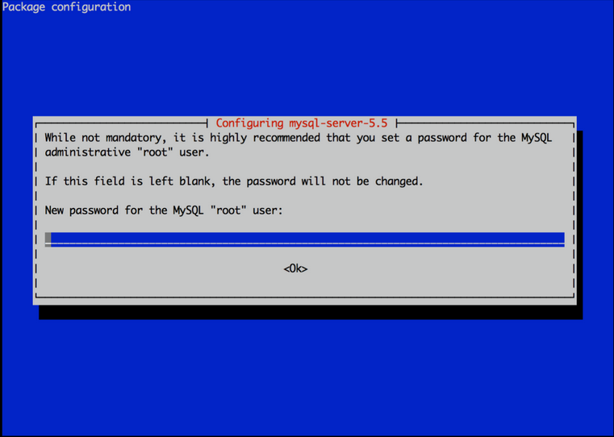
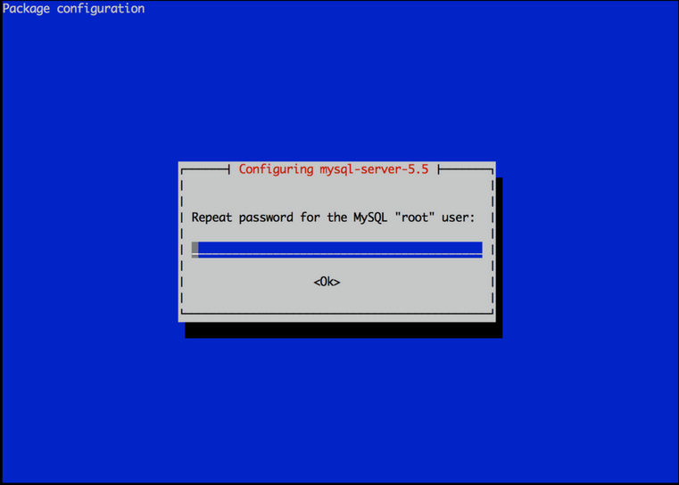
Setting up a MySQL Server
Choose a secure password, and keep it safe. You will need this later to create additional users for WordPress. You will be prompted to confirm your password:

Slide 15
Setting up a MySQL Server
Now we need to install a extra package, mysql-client.
mysql-client allows us to connect to our local MySQL server through the CLI:
sudo apt-get install mysql-client

Slide 16
Manage Database via Web
You can use PHP5’s module, phpmyadmin, to manage MySQL database through web page.
sudo apt-get install phpmyadmin
During installation of phpmyadmin, it will ask you to key in password (which is typed in the last step).

Slide 17
Manage Database via Web
Next, we need to alter the Apache configuration in order to access phpmyadmin. To do this, enter the following command to alter the configuration:
Sudo nano /etc/apache2/apache2.conf
The configuration file will load in Nano. Navigate to the bottom of the file (keep pressing CTRL + V to jump page by page until you’re at the bottom of the file) and add the following new line to the file:
Include /etc/phpmyadmin/apache.conf
Restart your apache server
sudo /etc/init.d/apache2 restart

Slide 18
Show Your Management Page
That’s it! You’re all installed and ready to go. Give accessing it a try by going to your Raspberry Pi’s IP address or domain name and add ‘/phpmyadmin’ to the end in your web browser, ie http://192.168.1.1/phpmyadmin.

Slide 19
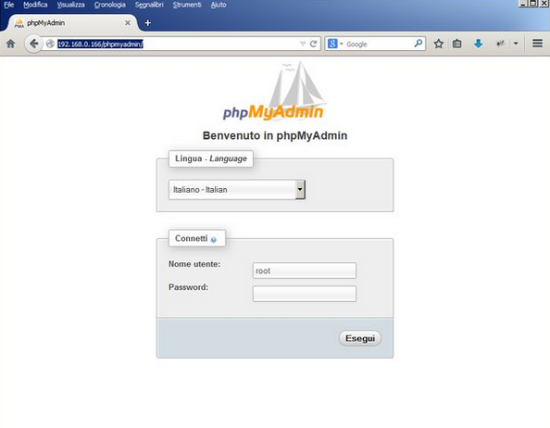
Show Your Management Page

Slide 20
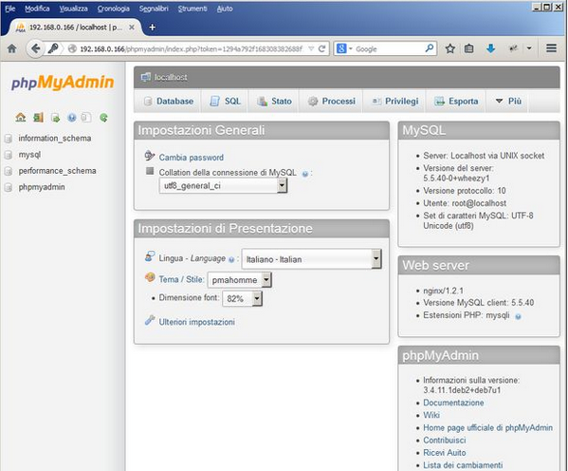
Show Your Management Page

Slide 21
Clear Failure of Installation
When you have a failure of installation on MySQL, or forget your username and/or password, you can remove your configuration on MySQL.
sudo apt-get autoremove –purge [filename]

Slide 22
Lab 1: WordPress
Build WordPress on Raspberry Pi to show your own blog
You need
Apache
PHP
MySQL

Slide 23
END

